Slide 1
Functional Programming for End-Users
towards a wide-spectrum computing environment
Enzo Alda and Javier Lopez – Lakebolt Research
Please send email to enzo@lakebolt.com to join the ZenSheet Beta

Slide 2
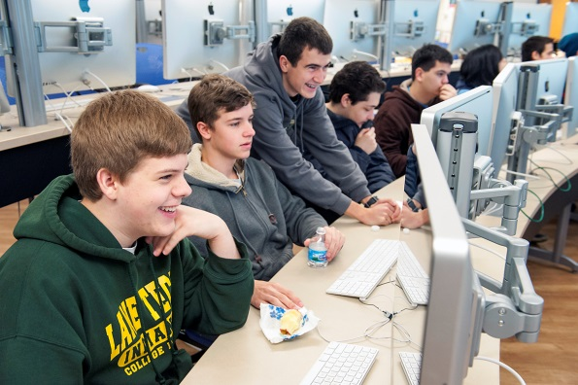
Wide-Spectrum Computing

Slide 3
Starting simple …baby steps …
lazy var x := 7;
lazy var y := ‘x ^ 2’;
CValue and RValue
CV(y) = x ^ 2
RV(y) = RV(CV(y)) = 49
RV(y) = RV(CV(y)) = RV(x ^ 2) = RV(x) ^ RV(2)
RV(CV(x)) ^ 2 = RV(7) ^ 2 = 7 ^ 2 = 49
Notes:
How could we start teaching someone in elementary school?
Define these variables using dialogs:
var x :- 7;
var y :- 8;
var z :- x + y;
Explain Cvalue and Rvalue
Reactive Computing: Mutable Input -> Functional Output
x :- 6 * 7;
x :- 7 + u();
x :- u();
y :- u();
z :- u();
MC on x
MC on x + y
MC on (x + y + z) / 3

Slide 4
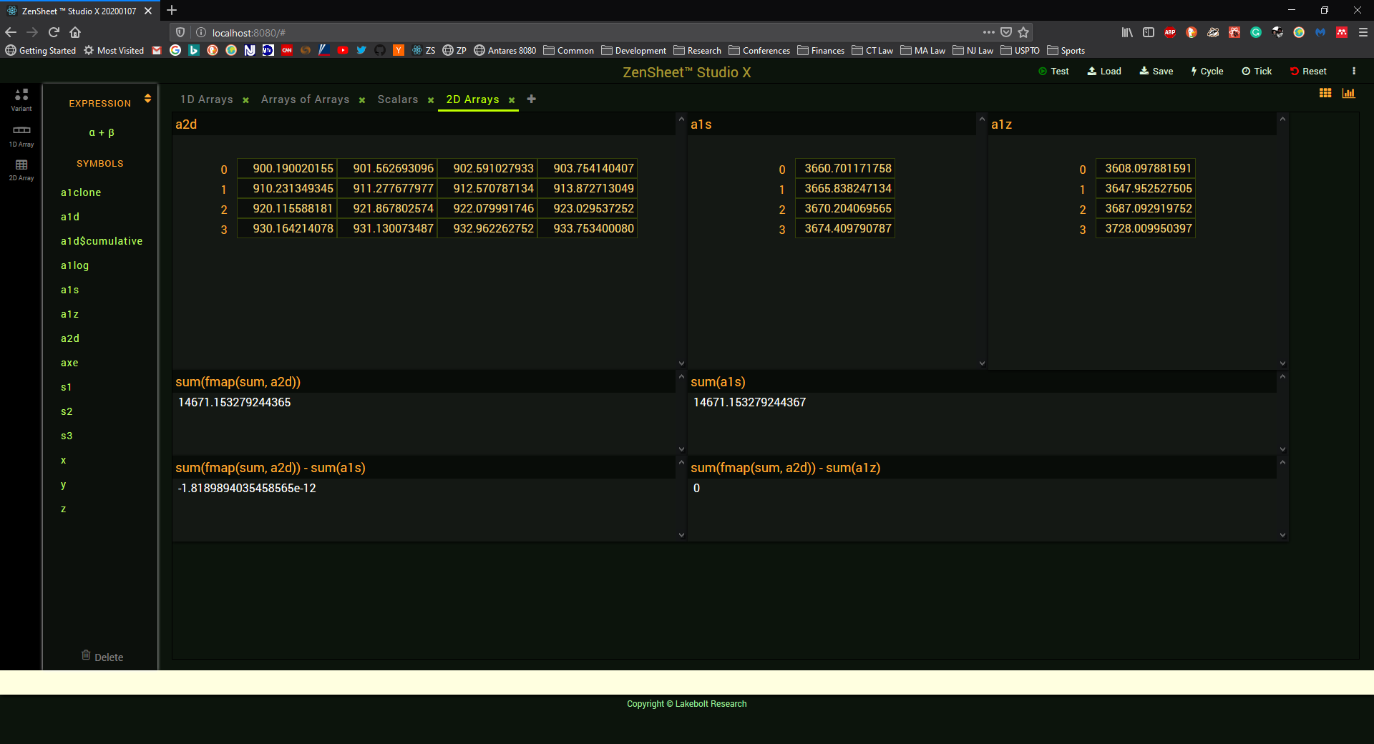
Arrays
Notes:
3 Boxes (continued)
Load arrays:
DD: array[] => var a1 :- [u(), u(), u(), u(), u(), u()];
Demonstrate insert, delete
DD: var a2 := ‘[u(), u(), u(), u(), u(), u()]’;
Demonstrate (on a1 and a2):
[] operator
[..] operator
MC on longer arrays

Slide 5
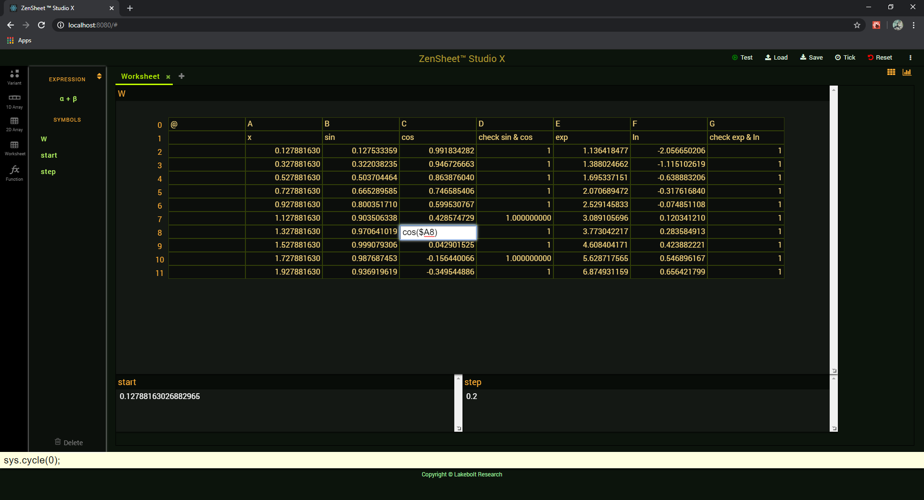
Worksheets
Notes:
Demo
Copy and paste values
Copy and paste formulae

Slide 6
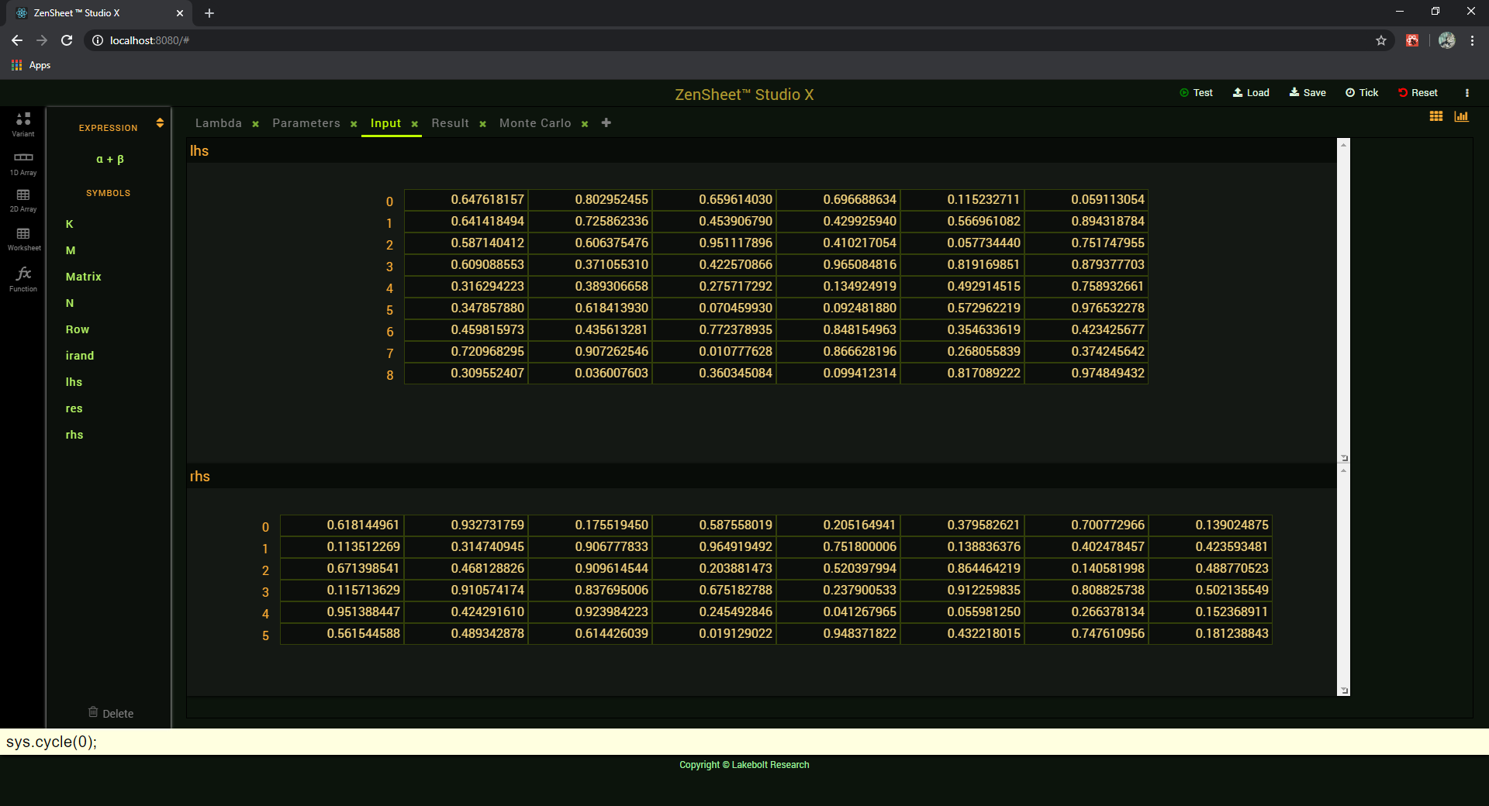
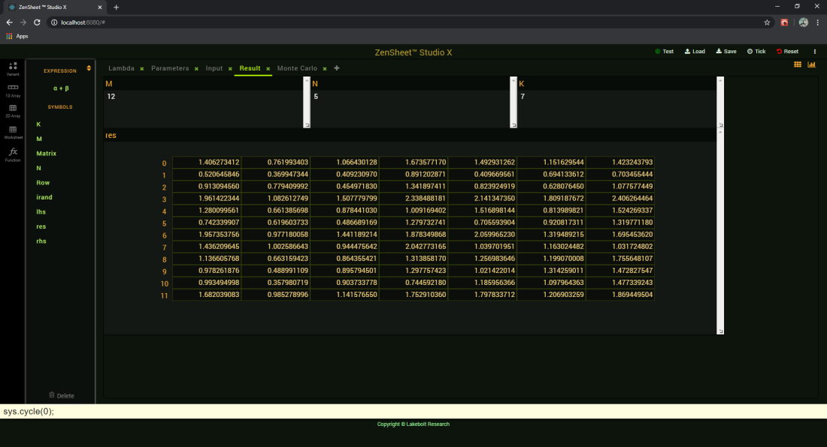
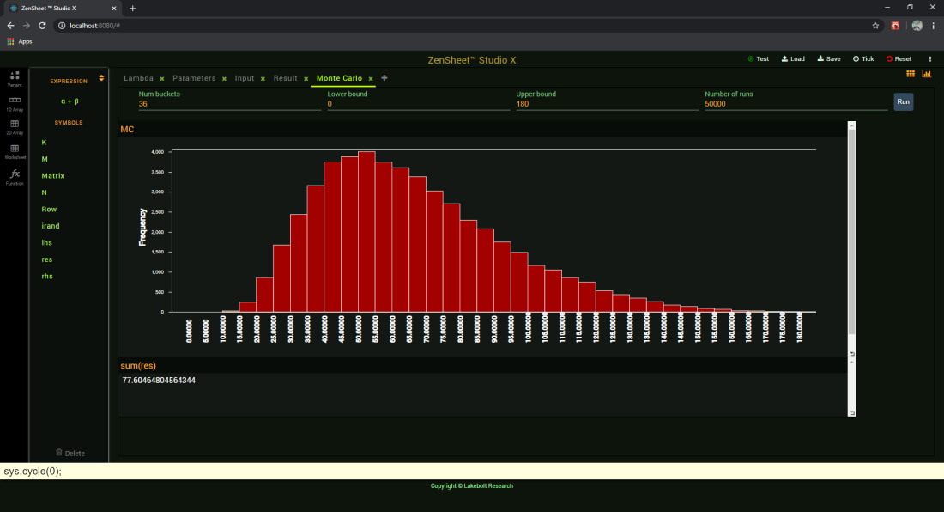
Array Formulae
Notes:
Demo
Model – View separation
Calling user defined functions
MC sum(fmap(sum(res)))
2D Arrays
DD: Array[6,6] => lazy var wx;
DD: Array[6,6] => lazy var wy;
[] operator
[..] operator
Worksheets: 2D arrays of lazy var
A1 notation
Insert row / col => A1 adjustments

Slide 7
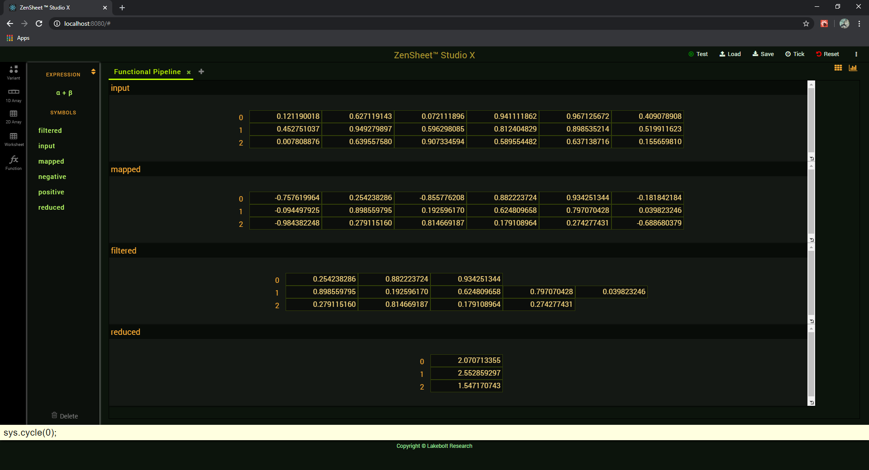
Functional Pipeline
Notes:
Higher order functions

Slide 8
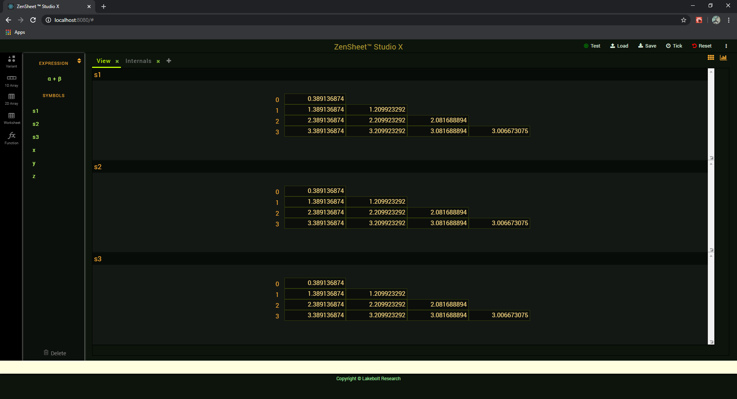
Containers and Laziness a tale of three triangles
Notes:
Explain and show differences
Explain compute cycle

Slide 9
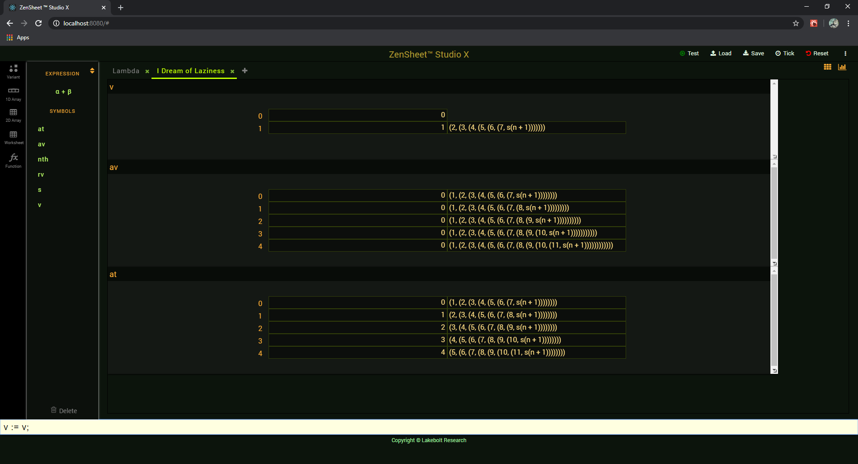
Lazy Evaluation
Notes:
Execute v := v; multiple times

Slide 10
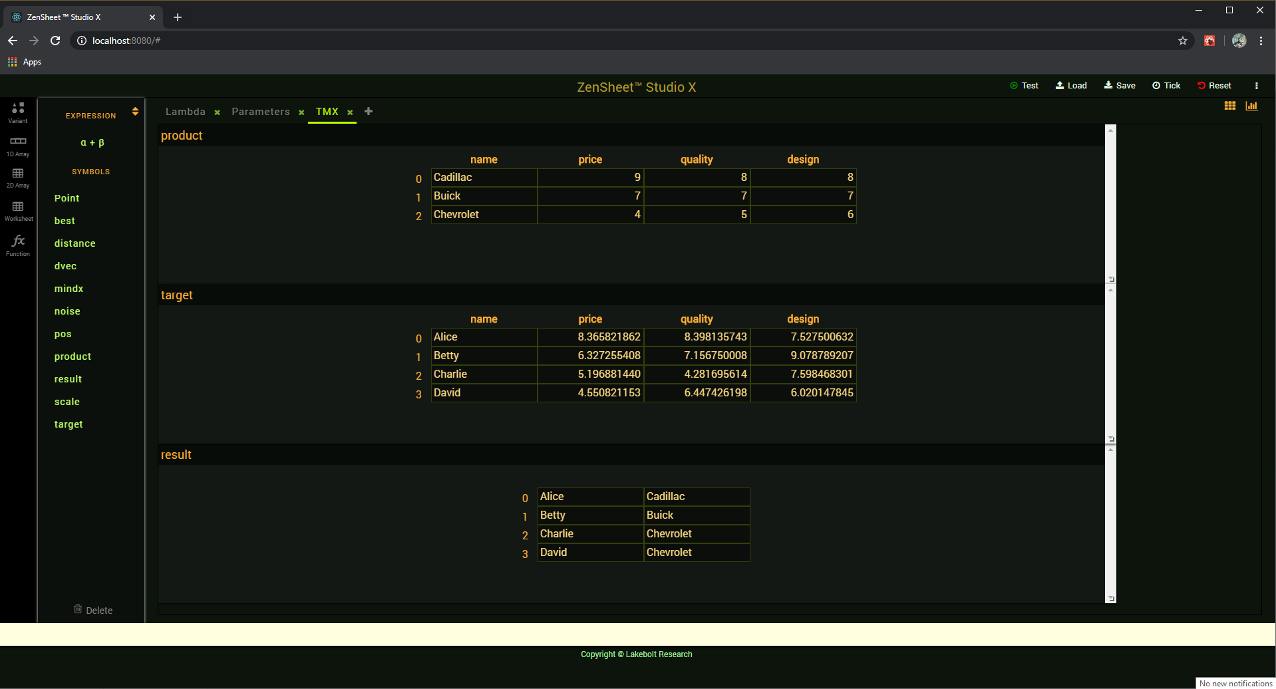
Putting it all together Targeted Marketing Simulation
Notes:
Targeted Marketing
Functional abstraction
Rich static typing
Separation of model and visualization
Gradual typing
Explain why it is hard to generalize this model in MS-Excel

Slide 11
The Spreadsheet Core
Expressions:
XLS.1) E → ? | <error> | true | false | <number> | <string>
XLS.2) E → <symbol>(E, ..., E)
XLS.3) E → <A1> | <symbol> ! <A1>
XLS.4) E → <A1>:<A1> | <symbol> ! <A1>:<A1>
Actions:
XLS.5) A → create <symbol>; | remove <symbol>;
XLS.6) A → <symbol> ! <A1> := 'E';
XLS.7) A → <symbol> ! <A1>:<A1> := values(<range>);
XLS.8) A → <symbol> ! <A1>:<A1> := formulae(<range>);
XLS.9) A → insert(<symbol>, dim, start, n); | delete(<symbol>, dim, start, n);
Notes:
This is what we call the spreadsheet core
What we have seen so far already generalizes the core
Note purely functional side
Note where <symbol> appears
Limitations of the spreadsheet core => next slide

Slide 12
Problems with Traditional Spreadsheets
Lack of functional abstraction
Considerable research work done on this
Poor type system
Unitype type system
Only one data structuring mechanism (finally being fixed)
A1 notation should be considered harmful
Entanglement of model and visualization
First recognized in the industry (Javelin)
Notes:
=> Limitations of the spreadsheet core

Slide 13
Lilly Types
ZT.1) T → null | error | bool | number | string
ZT.2) T → fun(T, …, T) => T
ZT.3) T → struct { T <symbol>, …, T <symbol> }
ZT.4) T → array[, …,] => T
ZT.5) T → lazy T
ZT.6) T → var
Notes:
Difference between tuples and records
No sum types yet, but are part of the plan
Operator [] on tuples
Syntactically we also have :: which is not a type
:<symbol>: instantiates <symbol> with the type
Structural (type alias) or Nominal (new type definition)
var = lazy var

Slide 14
Lilly Expressions
XLS.1) E → ? | <error> | true | false | <number> | <string>
XLS.3) E → < A1 > | <symbol> ! < A1 >
ZE.1) E → <symbol>
ZE.2) E → fn(T <symbol>, …, T <symbol>) => T -> E
ZE.3) E → E(E, …, E)
ZE.4) E → (E, …, E)
ZE.5) E → [E, …, E]
ZE.6) E → E[E, …, E]
ZE.7) E → E : E
ZE.8) E → E .. E
ZE.9) E → ‘E’
Notes:
Function definitions:
- Type inference not as strong as Hindley-Milner (but hopefully …)
- However, explicit annotations help people understand the function contract!
- When T is omitted, it is assumed to be var
Difference between E:E and E..E

Slide 15
Lilly Actions
ZA.1) A → T <symbol> := E;
ZA.2) A → E := E;
------------------------------------------------------------------------------------------------------
What? No loops?
What happened to this?
XLS.9) A → insert(E, dim, start, count); | delete(E, dim, start, count);
Well … and there are many other functions with side effects:
sys.reset()
sys.cycle(milliseconds);
sys.undefine(<symbol>)
Notes:
Besides not having loops we don’t have if actions either.
That’s only because we are delaying those imperative constructs for last
But we have other things to worry about
Syntactically, array insert/delete are “functions” calls
But they have side effects
Moreover, making functions “pure” or “quasi-pure” (random generators) and easily distinguishable from actions seems in principle desirable, but we want to create procedural abstractions for actions too. We could:
Differentiate array insert/delete adding new syntactic forms
Add an “impure” modifier for procedure definitions (what about the call though)
Accept that functions can have side-effects
e,g., syntax like:
f(x) for functions
call f(x) for procedures
Separate expressions and actions may be a pipe dream

Slide 16
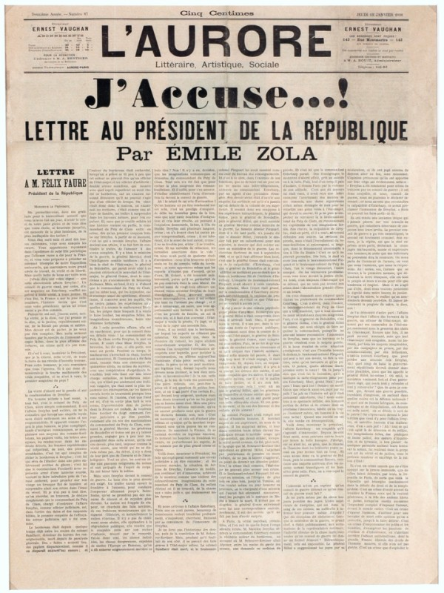
What we know
The ZenSheet project shows it is possible to deliver a consistent programming experience to a wide range of users by generalizing the spreadsheet core.
Our proposed generalization
Follows generally accepted principles of PLDI
Encourages a functional programming style
Can support real-life applications
Gradual Abstraction ⬄ Gradual Learning
Émile Zola, L'Aurore - Musée d'Art et d'Histoire du Judaïsme
Notes:
Worksheets “disappear” <= array[,] => lazy var
A1 magic
Spreadsheets “disappear”
As a tool: IDE for Lilly
As an instance (workbook): Lilly model
Databases should “disappear” too
Atomicity
Consistency
Isolation
Durability

Slide 17
What we want to do next
Sum types
Recursive types
More powerful type inference
Formal definition of compute-cycle evaluation semantics
Model sharing and support for DBMS concepts
Native compilation via LLVM
Implicit parallelization

Slide 18
Acknowledgments
Sponsor
Major Contributors
Monica Figuera
Pablo Escobar
Richard Lares
Juan Andres Escalante

Slide 19
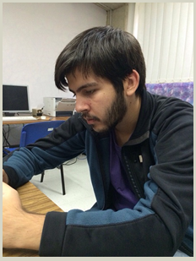
The ZenSheet Team

Slide 20
Special Forms
if(α, β, γ)
RV(if(α, β, γ)) = if RV(α) then RV(β) else RV(γ)
formula(E)
The expression must have LValue
formula returns the generalized CValue of the expression
generalized: because E could be a container
Notes:
Optional … if time allows
We could avoid implementing if as a special form, but doing so would force users to quote β and γ, which is clearly a non-starter: not consistent with the core’s IF function, would make spreadsheet practitioners’ heads spin, and … looks ugly too!
Function formula should have been mentioned in the Worksheet example

Slide 21
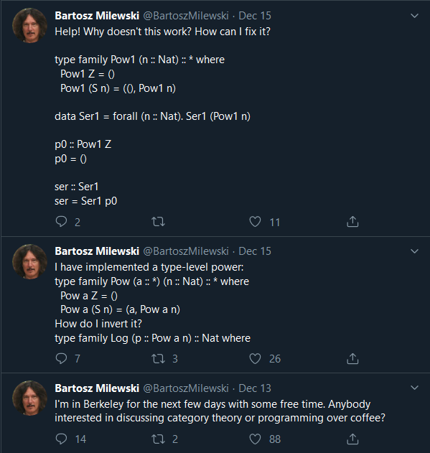
“let's be mainstream!” [Evan Czaplicki]
Notes:
Next
VM
sum types (with pattern matching)
parametric polymorphism
IDE
Better space utilization
Function editor
Experiment with students
More experiments with practitioners
More experiments with software engineers
Closing remarks
- Unification vs Specialization
Evan Czaplicki: "let's be mainstream!“

Slide 22
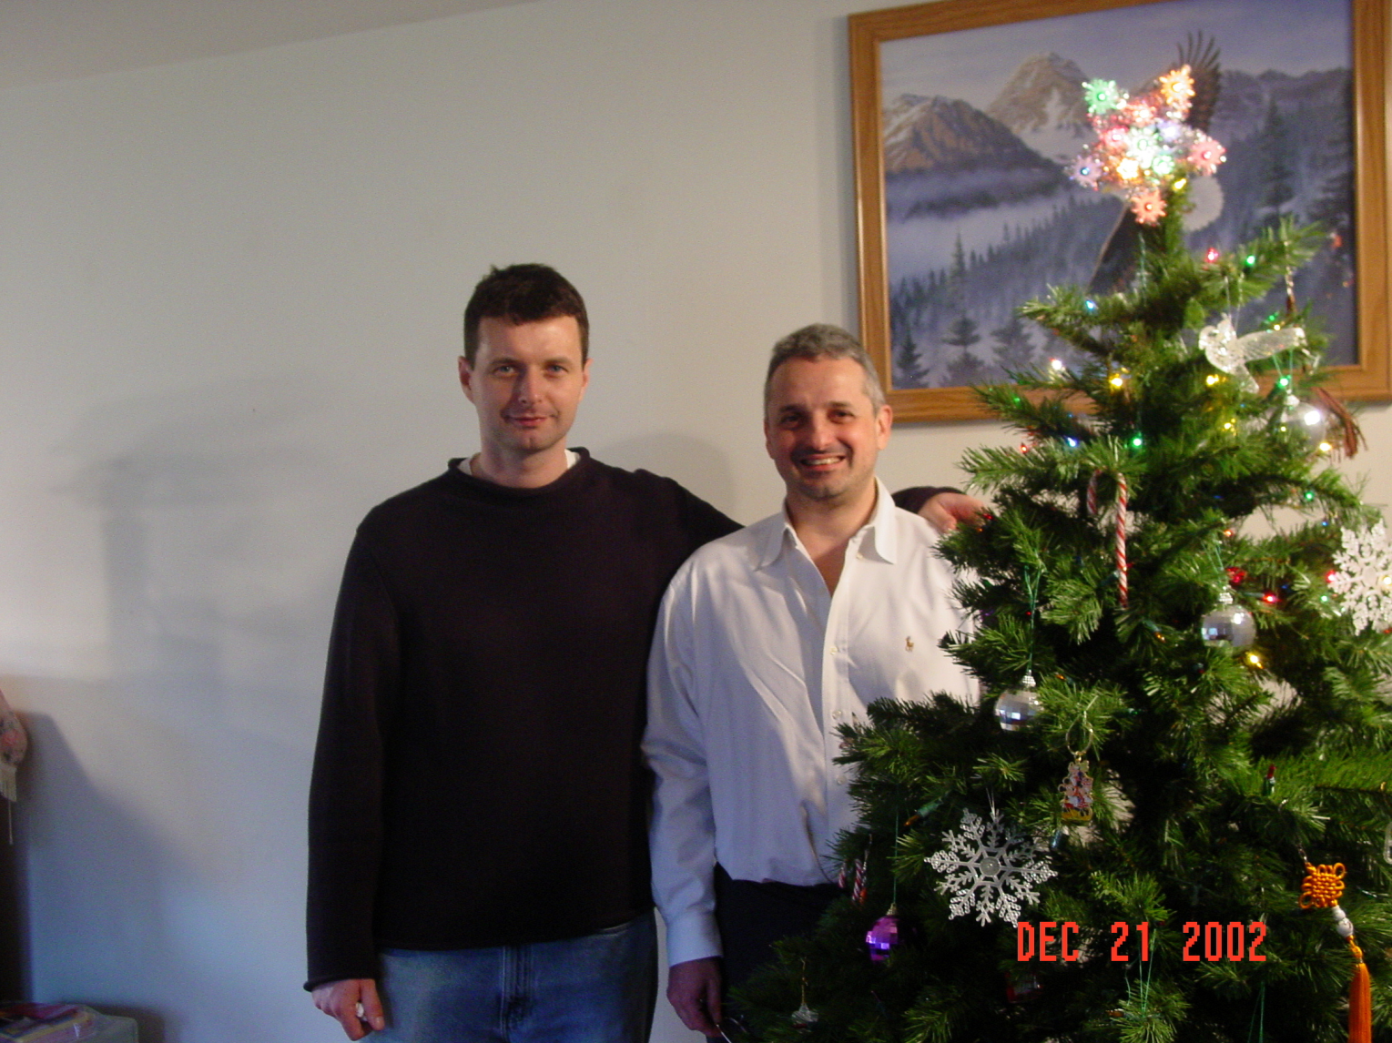
In memoriam
Peter Grządzielski

